Slide 1
Nerd Dinner With Brains
San Francisco F# User Group
March 24, 2015
James Dixon

Slide 2


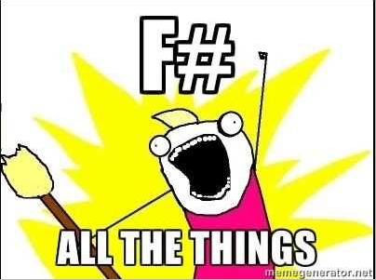

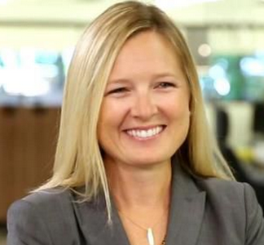
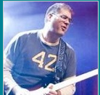

Language Choices
Notes:
Krysta Svore

Slide 3
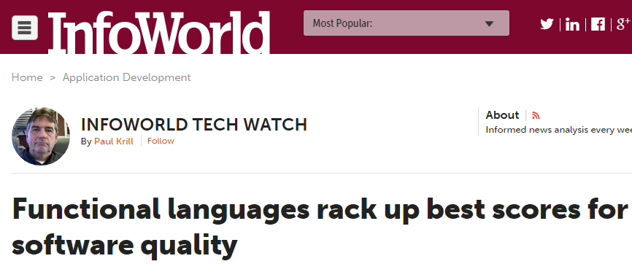
Language Choice
But the report noted the modest effects of language design are "overwhelmingly dominated by the process factors, such as project size, team size, and commit size.“
Balshakhi Ray, a postdoctoral researcher at the university who participated in the study, said in an interview that functional languages were boosted by their reliance on being mathematical and the likelihood that more experienced programmers use them.

Slide 4
2015 Pivot Points For The .NET Dev
Pivot To The User
Learn MVC5/WebApi2
Learn Angular/Knockout
Learn Win8/WPF
Learn UX Design
Pivot To The Data
Learn F#
Learn R
Learn Azure ML
Learn Basic Statistics

Slide 5
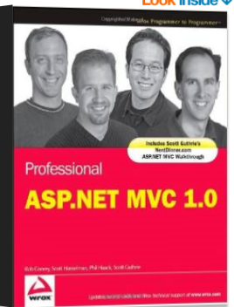
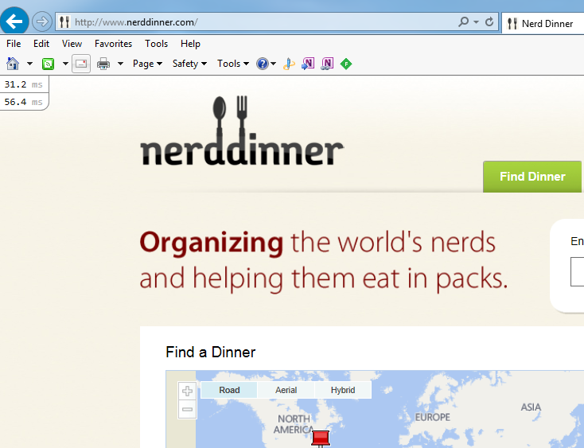
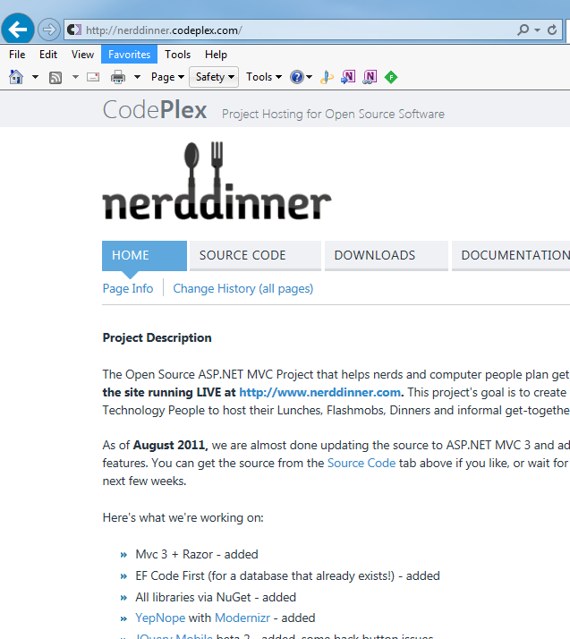
Nerd Dinner

Slide 6
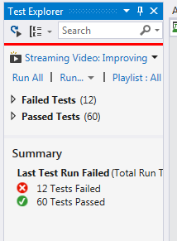
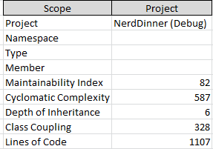
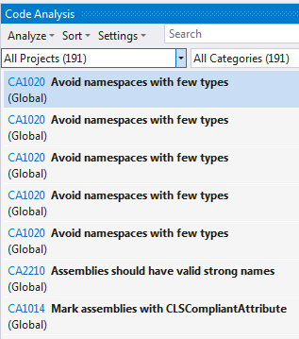
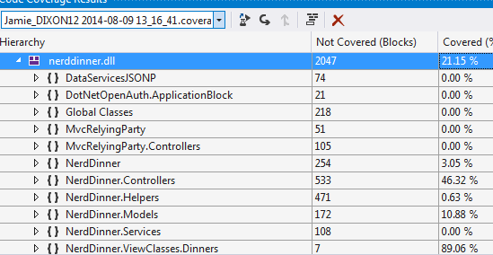
Nerd Dinner

Slide 7
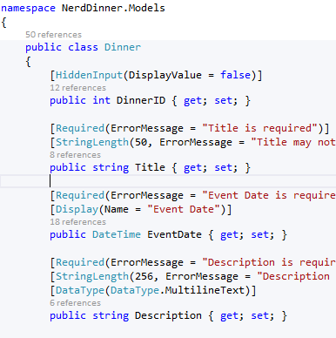
Business Logic?
~15 Lines
Input Validation

Slide 8
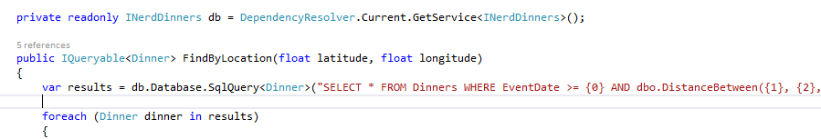
Business Logic
“Where” manipulation
~10 Lines

Slide 9
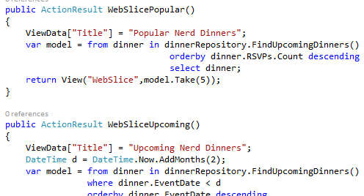
Business Logic?
Nerd Dinner is forms over data
Nerd Dinner is wire framing data
Nerd Dinner is transactions

Slide 10
Code
What questions do you want answered?

Slide 11
Wrap Up
github/jamessdixon/nerddinner
@jamie_dixon #TRINUG #fsharp #azureML
jamessdixon.wordpress.com
jamessdixon@gmail.com

